Slide 1
Distributed attack detection through inductive learning in IoT
Prepared by:- PROJECT MENTOR:
Aditi Singh(1719210019) DR. KAVITA SHARMA
Praveen Tripathi(1719210189)
Alankrit Agarwal(1719210033)

Slide 2
INTRODUCTION
An increasing number of Internet of Things (IoT) devices are connecting to the Internet, yet many of these devices are fundamentally insecure, exposing the Internet to a variety of attacks. Botnets such as Mirai have used insecure consumer IoT devices to conduct distributed denial of service (DDoS) attacks on critical Internet infrastructure.
This motivates the analysis of the techniques to automatically detect consumer IoT attack traffic. In this project, we demonstrate that using IoT-specific network behaviours (e.g. limited number of endpoints and regular time intervals between packets) to inform feature selection can result in high accuracy DDoS detection in IoT network traffic with a variety of machine learning algorithms.

Slide 3
OBJECTIVE
By all accounts, Internet of Things (IoT) devices are forecasted to become ubiquitous. However, the growing “smartness” of connected devices introduces security challenges. The idea of securing IoT devices can be daunting.
Security in the IoT implies the need for the defense of IoT applications and the IoT infrastructure.
In the IoT, a number of communication and control operations are performed among a diverse set of devices.
Alongside the development of Internet of Things (IoT), security attacks are also increasing day by day. So, we have proposed a centralized attack detection mechanism to detect attacks in IoT, using various machine learning algorithms.

Slide 4
SOFTWARE REQUIREMENT
Tensor Flow
Jupyter Notebooks

Slide 5
MOTIVATION / PROBLEM STATEMENT
The Internet of Things (IoT) is now widely used in various domains including smart buildings, power grids, entertainment, transportation, and health care. It is forecast to play a significant role in future technical revolutions, and its utilization is likely to increase exponentially over the coming years.
Due to the increasing number of IoT devices and the massive amount of data associated with them, the issue of security in the IoT has been raised. Security in the IoT implies the need for the defense of IoT applications and the IoT infrastructure. Many IoT devices can be easily targeted by intrusion because they are connected with outside resources at the network layer, and they do not have proper security defense. As such, an attacker can compromise the network layer and obtain control over an IoT device, which can then be used maliciously, or it can compromise other nearby devices connected to it.
According to a report from Statista, the number of devices connected through the Internet is expected to reach 75.44 billion. worldwide by 2025. The increasing number of IoT devices will provide many opportunities for attackers to compromise them through malicious emails, collusion attacks, and denial of service attacks among many other types of attack.
The existing mechanism for attack detection on wireless network works on the centralized cloud, which cannot satisfy the distinct requirements of the IoT, such as scalability, distribution, resource limitations, and low latency, to name but a few.

Slide 6
EXISTING SYSTEM / RELATED WORK
A number of centralized attack detection mechanisms have been proposed to detect attacks in IoT, wherein an attack detection system is deployed at the central point in the network that collects data from the network and classifies it as “attack” or “normal” using a supervised machine learning algorithm.
Note, however, that these mechanisms have failed to achieve significant results due to the distinct requirements of IoT devices, such as scalability, distribution, resource limitations, and low latency. Moreover, the application of supervised machine learning for classification needs a significant amount of labeled data.

Slide 7
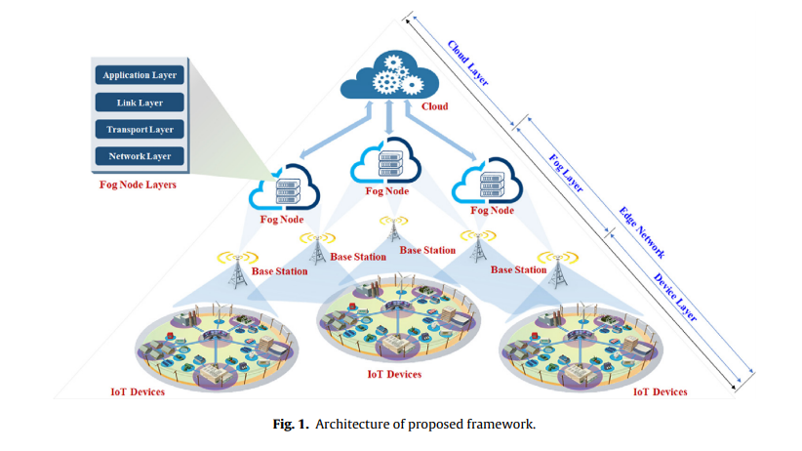
DIAGRAMATIC REPRESENTATION

Slide 8
PLAN OF WORK
This paper offers the following contributions:
This paper provides implementation of attack detection framework for IoT, which satisfies the distinct requirements of IoT such as distribution and lower detection time.
Analyzing the important features of protocols that play an important role in detecting a threat.
We compare and analyze the performance of various machine learning algorithms in detecting the threats.

Slide 9
TOOLS AND TECHNOLOGY
Tensor Flow
Machine Learning
Cloud Computing
Cyber Security

Slide 10
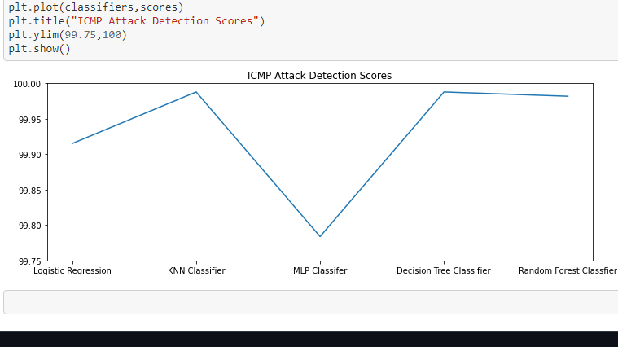
SCREENSHOTS OF RESULTS

Slide 11
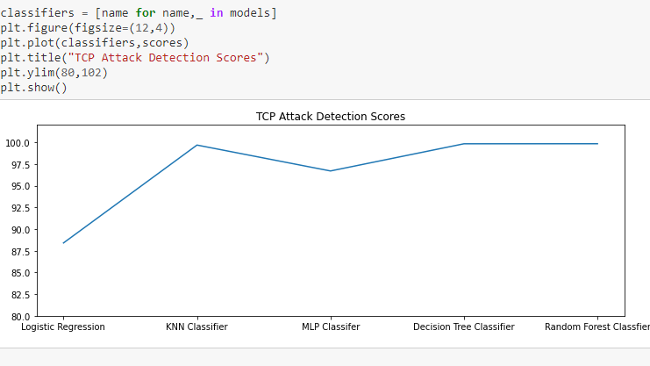

Slide 12
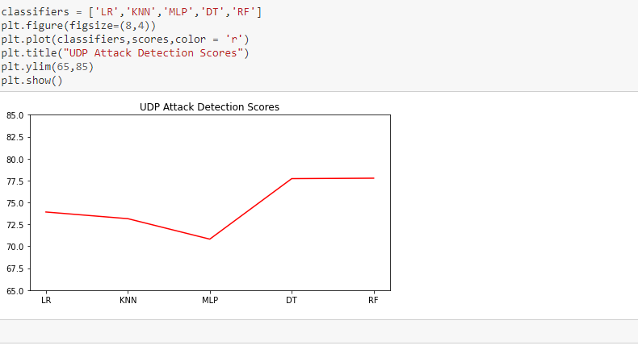

Slide 13
LIMITATIONS/CONSTRAINTS OF PROJECT
It requires huge amount data for performing complete analysis of the project.
It can only detect existing type of attack which are generally performed by the attackers like Distributed Denial of Service attack.
This model requires proper infrastructure and resources for performing operation smoothly.

Slide 14
REFERENCES
[1] P.K. Sharma, S. Singh, Y.-S. Jeong, J.H. Park, Distblocknet: a distributed blockchains-based secure sdn architecture for iot networks, IEEE Commun. Mag. 55 (9) (2017) 78–85.
[2] Statista, Internet of Things (iot) connected devices installed base worldwide from 2015 to 2025 (in billions), https://www.statista.com/statistics/471264/ iot-number-of-connected-devices-worldwide/, (accessed 30.10.17). 2018.
[3] S. Zeng, X. Tong, N. Sang, R. Huang, A study on semi-supervised fcm algorithm, Knowl. Inf. Syst. 35 (3) (2013) 585–612.
[4] Y. Meidan, M. Bohadana, A. Shabtai, M. Ochoa, N. O. Tippenhauer, J. D. Guarnizo, Y. Elovici, Detection of unauthorized iot devices using machine learning techniques, arXiv preprint arXiv:1709.04647.

Slide 15
THANK YOU!

